Slide 1

Massive scale with Azure Event Hubs for IoT
Not your Grandma’s Queue…
Presenter: Rob Chartier
http://robchartier.io
Content:
https://goo.gl/II1vh4

Slide 2
Event Hubs – 50,000 View
Think of it as a Queue, just on steroids (the good kind)
A queue with built in ability to shard, scale, stream, etc.
When they are setup the have a fix partition count
Great for Telemetry ingestion, large amounts of telemetry from large amounts of concurrent publishers
Consumers are CPU Bound, so can be scaled with ease
Can handle millions of events per second
Support HTTP and AMQP as transport layers (hey IoT!)
Very similar to Kinesis on AWS

Slide 3
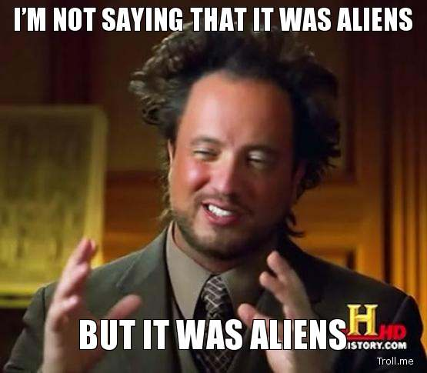
Why not a Queue?
Don’t use alien tech...
EventHubs were built from the ground up for IoT and Telemetry ingestion.
High throughput and processing flexibility is the main concern
We don’t need sequencing, dead-lettering, transactions, nor strong delivery assurances that come with Queues
No need to implement your own sharding mechanism

Slide 4
Event Hub – Setting up
Create our Service Bus Namespace
Create our Event Hub within the SB Namespace
Custom Create
Default Partition Count: 4, can go up to 1024….
Max retention for basic is 1 day, typically no more than 7 days
3. At the Service Bus Namespace level, we can get the connection string
4. Or define a SAS (shared access signature) policy at the EventHub level
For example: Read only, Write Only, and Read/Write access

Slide 5
Concepts - Consumer Groups?
This is the core pub/sub mechanism
Each consumer group is a “view” for an Event Hub
State, Position and Offset
EventHubs have a single input, but through Consumer Groups you can have many outputs
Each have their own view of the data
Each can read the stream independently at their own pace and offsets
But why?
Streaming Analytics
PowerBI
Table Storage
Etc..

Slide 6
Concept - Partition Key
As you send a message to the Event Hub…
You set the PartitionKey on a message to instruct that this his HOW to bucketize the incoming messages
Essentially HASH(PartitionKey)%PartitionCount
Guaranteed order and all messages with the same PartitionKey will end up on the same Processor (consumer instance)
Causes a reduction in overall throughput
No PartitionKey means that it will get put into any available bucket
No guarantee of order nor processor
Recommended, if your scenario calls for it
Its just a string

Slide 7
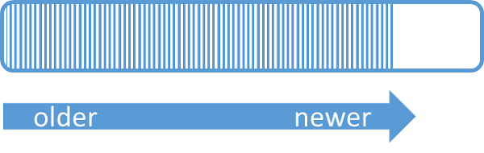
Concepts - Partitions
A partition is an ordered sequence of events that is held in an Event Hub.
FIFO is at the Partition Level, not the Event Hub
As newer events arrive, they are added to the end of this sequence.
A partition can be thought of as a "commit log.“

Slide 8
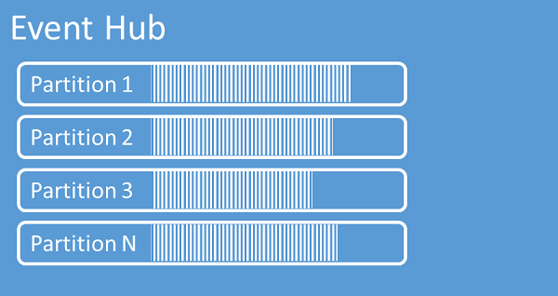
Concepts - Partitions
You set the number of partitions on the Event Hub to instruct Event Hubs to divide your incoming messages into that number of “buckets”
They retain data for a configured retention time
You cannot explicitly delete them
An Event Hub contains multiple partitions.

Slide 9
Concepts - Checkpoints
Checkpoints exist on each Event Hub, per Consumer Group, across all partitions
Remember:
Each consumer group is a “view” for an Event Hub
State, Position and Offset
Checkpoints persisting a reference point into our Consumer Group. (Position, Offset)
This avoids replaying the same messages
Checkpoints are NOT automatic. You have to handle this yourself, depending on your own specific business requirements.

Slide 10
Checkpoint Strategies
Time duration where it is acceptable to replay events within that duration (the last X minutes)
Message count where it is acceptable to replay events within that count (the last N messages)
Every time
Generally considered a bad idea
It is resource intensive

Slide 11
Concepts Summary
Consumer Groups
Multiple “views” on an Event Hub
Partition Key
A way to shard your data into buckets, FIFO
Use something from your own domain. Device Id, etc..
Partition Id
A number which represents the bucket
Checkpoints
To indicate that a set of messages have been processed
Avoids replaying the same messages

Slide 12
Event Hub – Sending Demo
Native Client (AMQP or Http)
Http Client (IoT Scenarios)

Slide 13
Event Hub – Setting up to receive messages
Need to create a Storage account for the client to manage Leases on our partitions
The EventHubProcessorHost is a high level abstraction above a basic Event Hub Consumer.
It automatically manages which consumer (worker role) is connected to each partition on the Event Hub
It is needed in order to guarantee a single consumer per partition in our Event Hub

Slide 14
Event Hub – Receiving Demo
Service Bus Explorer
Code Samples…
Basic - consuming events
Bad – consuming events improperly
Better – consuming events with partitioning

Slide 15
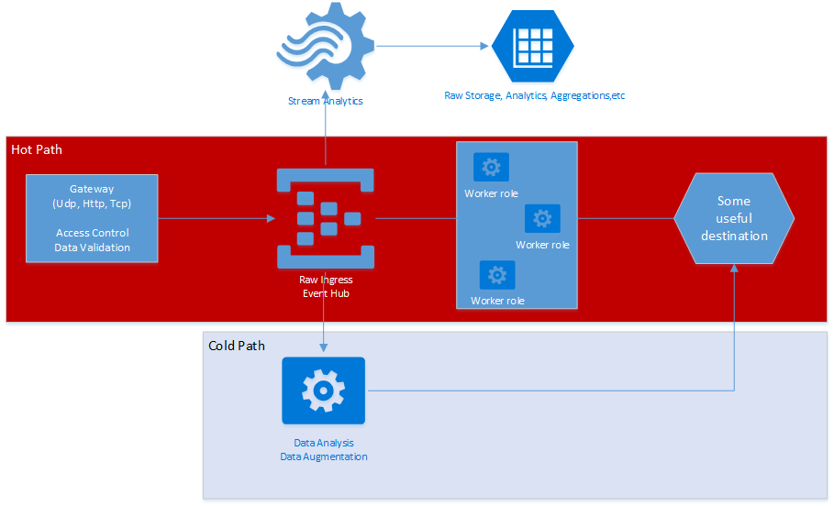
Reference Architecture – Ingress Only

Slide 16
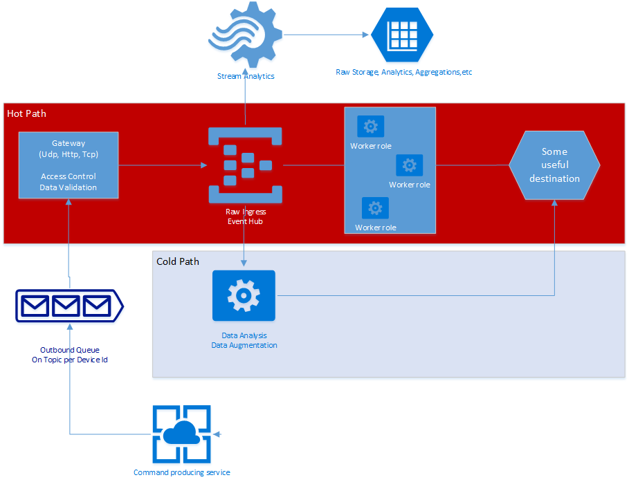
Reference Architecture – Command and Control

Slide 17
Hot vs Cold Path
Make sure you optimize the Hot path.
Focus on what is important between the device and the consumer
Use streaming analytics for persistence
Its better to NOT use any of your custom worker roles in the Hot Path, minimize it as much as you can.

Slide 18
Resources
Check the “Tools” folder in the GitHub Repo
GitHub Repo for this presentation: https://goo.gl/II1vh4
Azure Event Hubs overview
https://azure.microsoft.com/en-us/documentation/articles/event-hubs-overview/
Get started with Event Hubs
https://azure.microsoft.com/en-us/documentation/articles/event-hubs-csharp-ephcs-getstarted/
Event Hubs Signature Generator 0.2.0.1
https://github.com/sandrinodimattia/RedDog/releases/tag/0.2.0.1
Send Data into Azure Event Hubs using Web Api’s HttpClient
https://blogs.endjin.com/2015/02/send-data-into-azure-event-hubs-using-web-apis-httpclient/
Service Bus Explorer
http://blogs.msdn.com/b/paolos/archive/2015/03/02/service-bus-explorer-2-6-now-available.aspx

